Slide 1
Converging lines and ANU Open Research
Elke Dawson
Manager, Open Research
Scholarly Information Services
ALIA Universities and Research Libraries (URLs) Seminar
Strange bedfellows: partnerships and collaborations in the age of digital disruption National Library of Australia, 14th September, 2017
This work is licensed under a Creative Commons Attribution 4.0 International License.
http://orcid.org/0000-0002-9881-2423

Slide 2
What is the problem?
Content: Jill Cirasella. Graphics: Les Larue. License: Creative Commons: Attribution, Non-Commercial.

Slide 3
So why Open Access?

Slide 4
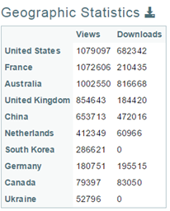
How is ANU Open Research helping researchers?
Discoverability
Via search engines and the internet generally
New additions to Open Research harvested overnight
Leading to increased interest and the facilitation of future collaborations.
Visibility
Raises a researcher’s profile as well as growing their web presence and reach
2011
2017 to date
2011 to 2017

Slide 5
How is ANU Open Research helping researchers?
Capturing
ANU research publications - books, book chapters, journal articles, conference papers, NTROs e.g. creative works and now research data
Describing, preserving and / or linking to them
Identifying those that are open access and hence
Compliant with funder publishing mandates e.g. ARC and NHMRC
Publishing
Theses – PhD, Masters (all) and Honours (some)
Grey literature (e.g. conference posters, working/technical papers etc.)
Certain forms of research data e.g. appendices; supplementary material not accepted by a journal etc.
Great for HDR’s & ECR’s just embarking on their research careers as well as the HASS sector who publish outside the mainstream.

Slide 6
How is ANU Open Research helping researchers?
Permanence
Stable and permanent links – currently hdl (a form of DOI – digital object identifier) and eminently suitable for citation purposes and hence use on a CV, profile page and in grant applications.
Preservation
Located in an institution (ANU) and organizational unit (Library) highly likely to be here in 50/100/200 years ….
Promotion, collection and currently source of truth for
ORCiD (Open Researcher and Contributor iD) and other Researcher IDs
Training
Research Data Management
Bibliometrics and Altmetrics
Creating and maintaining an online Research profile
Open Access and CC licencing

Slide 7
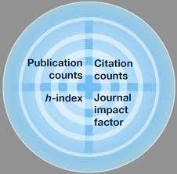
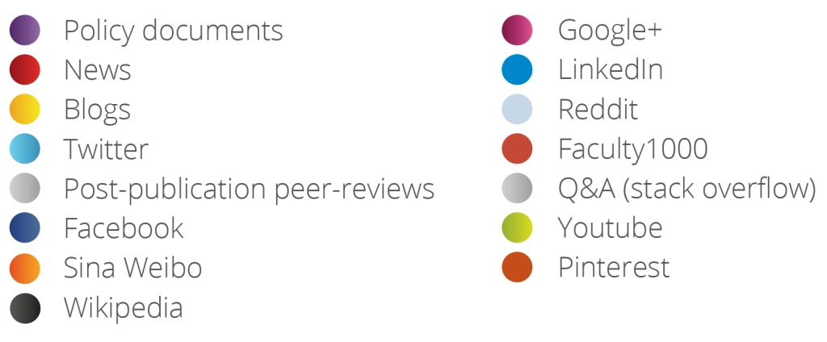
Open Research helping to gauge engagement & impact
Bibliometrics
Measuring impact
Predominantly STEM
Altmetrics
Measuring engagement
Great for ECRs and HASS

Slide 8
Future Plans
Integration with the University’s new Research Information Management System (RIMS)
Minting / creating DOIs via DataCite for
ANU theses, grey literature and NTROs to enhance discovery, engagement and citations
Capturing and preserving ANU collections - past, present & future
Pacific Institute Digitization Project
Australian Primary Health Research Institute (APHCRI) – 2003 - 2015
Urban Research Working Papers in conjunction with APO (Analysis & Policy Observatory)
College of Asia and Pacific Map collection
Encouraging the University’s Research Centres to use Open Research as the permanent storage system for their publications, instead of their web servers, and only linking from their web sites.

Slide 9
Thank you
W: http://openresearch.anu.edu.au
E: repository.admin@anu.edu.au
T: ANU Open Research @ANUOpenAccess
P: +61 2 612 59729
F: Still thinking about it

Slide 10
Converging lines Libraries and Research Offices
Dr D.W. Robertson Director of Research Services ANU
September 2017

Slide 12
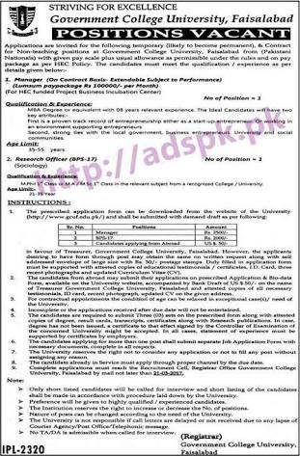
More noted for our absence than our presence!

Slide 13
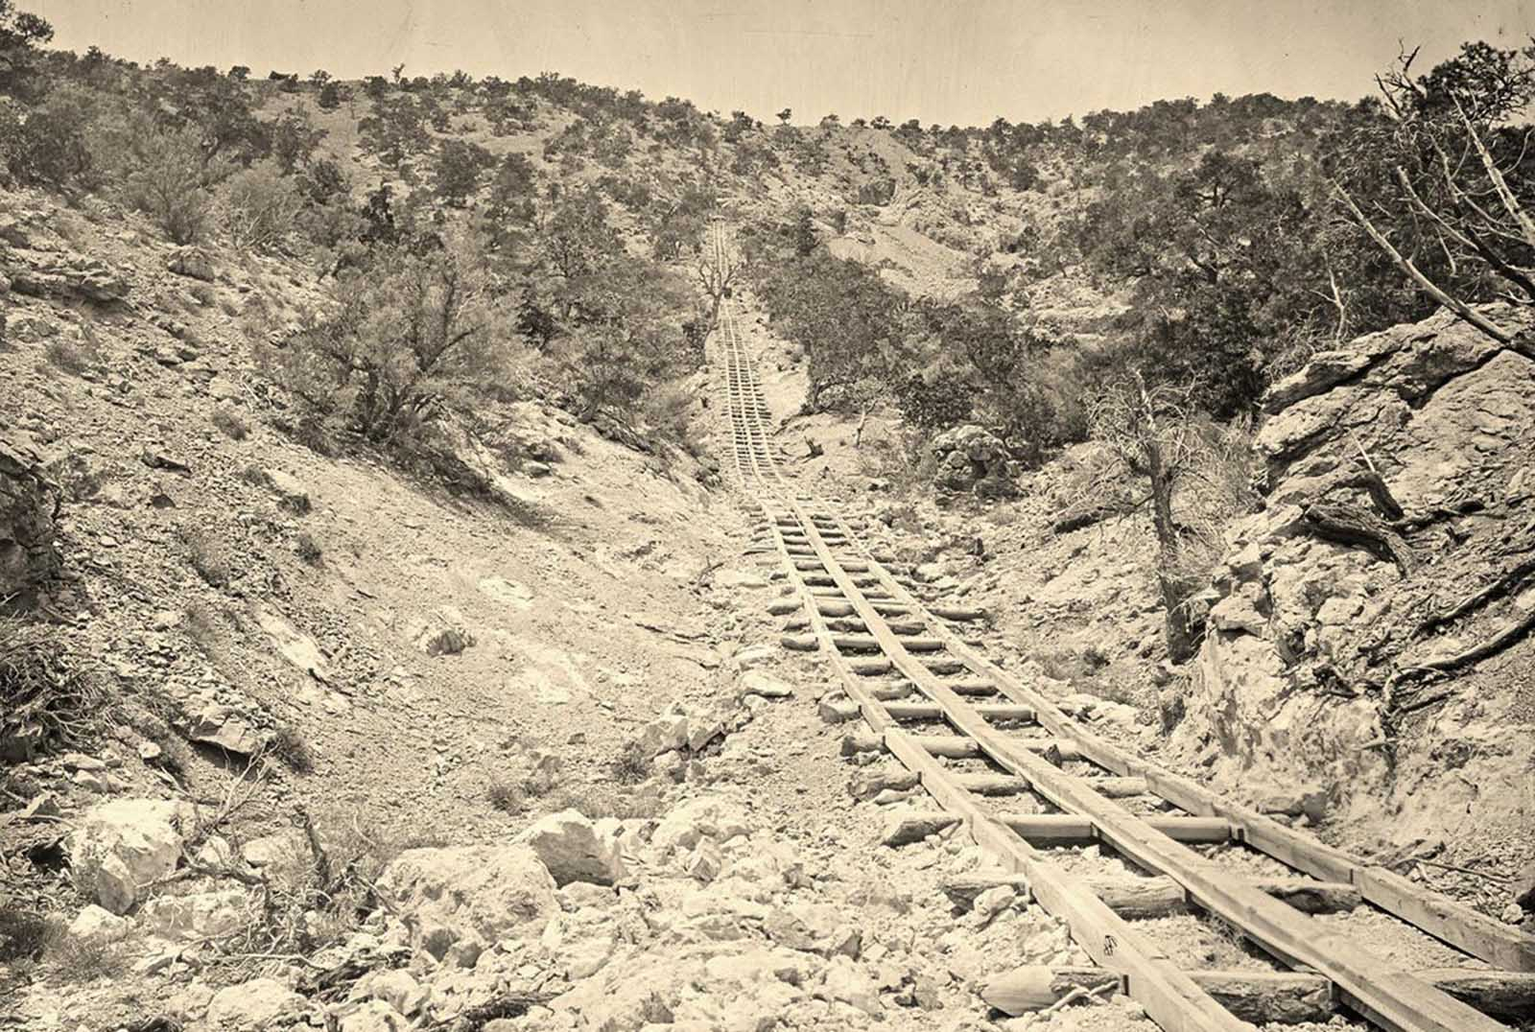
Early days of open access for librarians a clear direction but heavy going

Slide 14
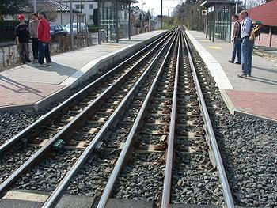
We travelled in the same direction but parallel tracks

Slide 15
Researcher acceptance
National policy
Discipline and publication specific leadership
Funder environment
Researcher resistance

Slide 16
GRANT REPORTS
ERA SUBMISSION
REPOSITORY
LIBRARY
PUBLICATIONS
DATABASE

Slide 17
GRANT REPORTS
ERA
SUBMISSION
REPOSITORY
LIBRARY
PUBLICATIONS
DATABASE

Slide 18
OPEN
DATA

Slide 19
And one of these days we will be on a train!!

